Slide 1
Northeast Renewable Diesel Working Group
Session 2 – August 6th, 2025

Slide 2
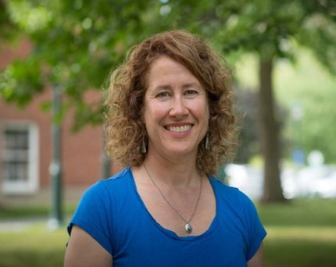



Vermont and Maine Clean Communities
Peggy O’Neill-Vivanco
Jon Gagne
Vermont Clean Communities
Coalition Director
Maine Clean Communities
Coalition Co-Director

Slide 3
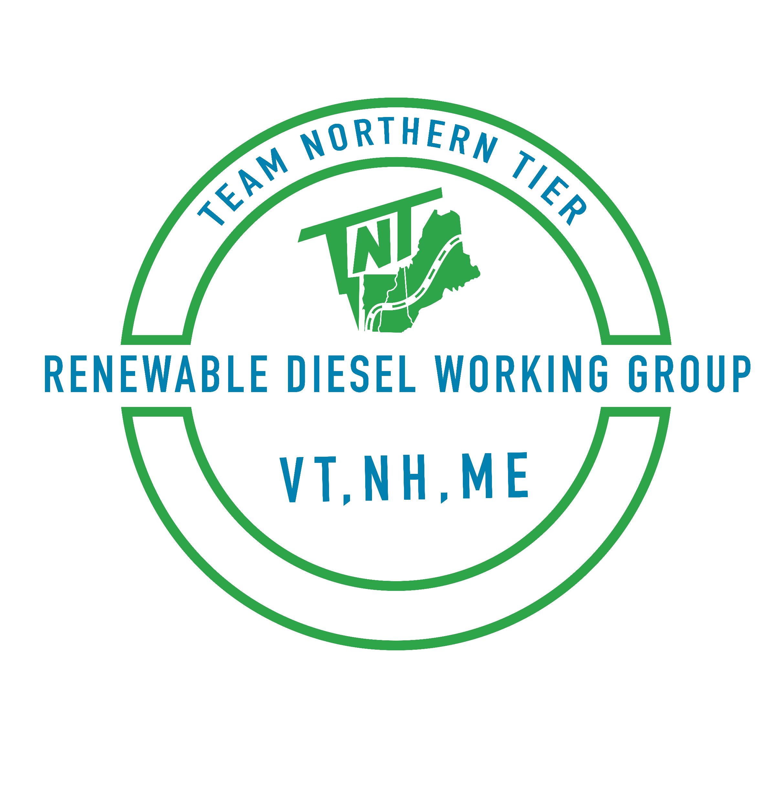
Agenda
Welcome & Recap
Logistics Deep Dive: Industry Presentations
Group Q&A with speakers
Group Discussion
Wrap-up & Next Steps
Working Group Session 2
Topic: Renewable Diesel Logistics

Slide 4
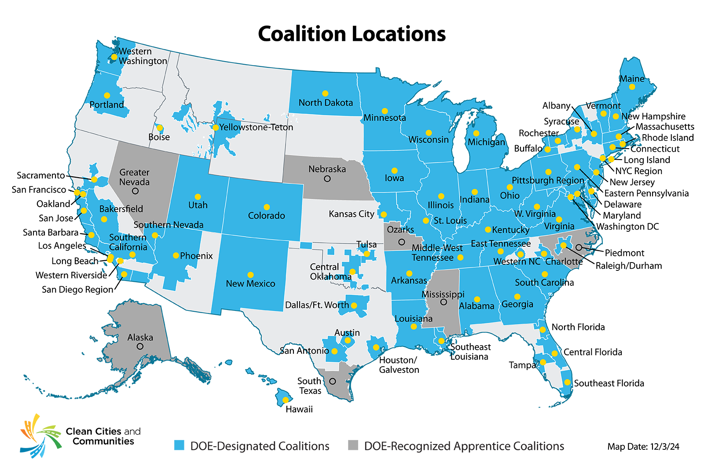
What We Do
Clean Cities and Communities is a U.S. Department of Energy (DOE) partnership to advance clean transportation nationwide.
More than 75 DOE-designated Clean Cities and Communities coalitions work locally in urban, suburban, and rural communities to strengthen the nation’s environment, energy security, and economic prosperity.
Notes:
Clean Cities and Communities is a U.S. Department of Energy partnership to advance clean transportation nationwide.
So, what does that mean?
Coalitions work locally in urban, suburban, and rural communities across the country. We advance affordable, efficient, and clean transportation, energy efficient mobility systems, and fuel-saving technologies and practices.
Coalitions are partners with the U.S. Department of Energy, or DOE. We bring expertise from federal agencies, national laboratories, and fellow coalitions directly to the communities we serve to develop and implement clean transportation solutions based on our knowledge of local needs, opportunities, and markets.
Our relationships allow us to build connections between DOE and local communities by leveraging national-level expertise to provide technical assistance to the regions we serve.
We also share insights and feedback from our on-the-ground deployment efforts and local stakeholder engagement to inform DOE activities, resources, and priorities. It’s a collaborative feedback loop with the Technology Integration Program team in DOE’s Vehicle Technologies Office.
Our coalition and the others around the country help local decision makers and fleets understand and implement clean transportation technologies and choices, including:
Shifting to affordable, efficient, and clean transportation fuels and technologies
Reducing greenhouse gas emissions
Assessing shared mobility options
Improving equitable access to advanced transportation.

Slide 5

Clean Cities and Communities Mission
Clean Cities and Communities advances the nation’s environment, energy security and economic prosperity through collaboration with communities by building partnerships with public and private stakeholders that create equitable deployment of clean transportation solutions for all.
Notes:
The Clean Cities and Communities partnership works toward a unified mission to advance the nation’s environment, energy security and economic prosperity through collaboration with communities by building partnerships with public and private stakeholders that create equitable deployment of clean transportation solutions for all.

Slide 6




Strategically Advance Clean Transportation
Access technical assistance and hands-on problem-solving support.
Connect to unbiased, data-driven tools and resources
Build partnerships
Receive personalized experience rooted in local context
Collaborate on funding opportunities
Notes:
Coalition staff provide technical expertise and hands-on problem-solving support to tailor clean transportation projects to unique needs. This expertise includes:
Evaluating the clean transportation technology options that meet on-the-ground needs and can reduce costs, energy consumption, and traffic congestion
Developing strategies to reduce emissions of greenhouse gases and other pollutants
Building collaborative relationships with communities, fleets, and industry partners to solve problems and identify and address technology barriers
Identifying funding opportunities for clean transportation and assisting with navigating funding application processes.

Slide 7

Introductions
Please introduce yourself in the chat
Name
Organization
Why are you interested in renewable diesel?

Slide 8



Jumpstart Funding
National Renewable Energy Lab
Connect Stakeholders
Assess current and future demand for renewable diesel
Consider heavy-duty on- and off-road applications, including agriculture, the ski industry
Determine fueling needs, capacity, training needs and cost effectiveness to transition to renewable diesel
Market Development
Fleet Solutions
Notes:
Now, I wanted to give a little more context behind this work and why we’re doing it. This quarterly working group session is a results of both Vermont and Maine Clean Communities receiving funding from the National Renewable Energy Lab, or NREL, to coordinate and convene these quarterly working group sessions.
We’ve learned a lot about renewable diesel since we started discussions with stakeholders and fleets in the Northeast over a year ago, which led to use hosting our first renewable diesel webinar in September of 2024. Building off the success from that webinar, we wanted to do a deeper dive to assess the current and future demand for renewable diesel, consider heavy-duty on- and off-road applications, and understand fueling needs, capacity, logistics and cost needed to bring RD further norther.

Slide 9


Session Topics
Renewable Diesel Introduction
Logistics
Session topics and the agendas will remain flexible to respond to what fleets find the most beneficial
Policy
Implementation
Renewable Diesel Market Development in the Northeast

Slide 10

Renewable Diesel Biodiesel
Renewable Diesel - fuel made from fats and oils, such as soybean oil or canola oil. It is processed to be chemically the same as petroleum diesel. Meets the ASTM D975 specification for petroleum in the United States. Renewable diesel can be used as a replacement fuel or blended with any amount of petroleum diesel.
Carbon Intensity - measures total greenhouse gas emissions across the full life cycle of a fuel, from production to use.
Biogenic CO₂ Emissions - are CO₂ emissions related to the natural carbon cycle, as well as those resulting from the combustion, harvest, combustion, digestion, fermentation, decomposition, or processing of biologically based materials.
Notes:
renewable diesel reduces carbon intensity on average by 65% when compared with petroleum diesel.

Slide 11
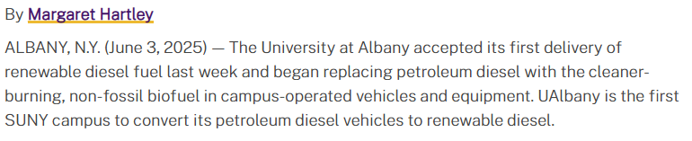
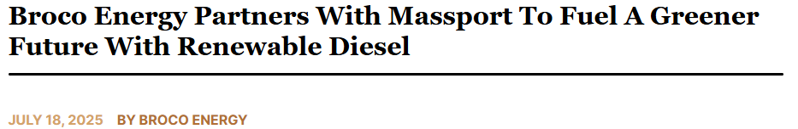
Renewable Diesel in the Northeast is Growing
Notes:
The Clean Cities and Communities partnership works toward a unified mission to advance the nation’s environment, energy security and economic prosperity through collaboration with communities by building partnerships with public and private stakeholders that create equitable deployment of clean transportation solutions for all.

Slide 12


Shailesh Gongal
Manager Aviation Planning
Massachusetts Port Authority
Renewable Diesel Pilot
Tom Bradley
VP of Sustainability
Boyne Resorts
Fleet End User

Slide 13

Renewable Diesel Q & A

Slide 14
Roundtable Discussion

Slide 15

Yellowstone-Teton Clean Cities
Renewable Diesel Working Group
Next session: August 13th 4:00PM EST
Notes:
https://us06web.zoom.us/meeting/register/tZYpcOGhrzMrHdXllxAWDw4Qszrh9EW62sGq#/registration
Resources: https://ytcleancities.org/projects/fuels/#tab-id-22

Slide 16
Key Takeaways
Renewable diesel can be a bridge fuel for electrification
The Northeast needs anchor volume to increase availability
Renewable diesel has been successfully deployed in
snowy climates up to R100 - may involve some blending
There have been price premiums initially (~$1.00), but demand or blends can shift that premium
Talk to a variety of providers to ensure supply and blend requirements can be met
Renewable diesel is looking at the total lifecycle emissions in reporting

Slide 17
Thank you
Peggy O'Neill-Vivanco: poneillv@uvm.edu
Jon Gagne: jgagne@gpcog.org
Next session: Policy
Wednesday, November 5th Noon – 1:30PM

Slide 18









































Icon Library – Modes of Transportation

Slide 19












Icon Library – Fuels and Technologies

