Slide 1
Northeast Renewable Diesel Working Group
Session 3 – November 5th, 2025

Slide 2

Introductions
Please introduce yourself in the chat
Name
Organization
Where are you calling in from?

Slide 3




Vermont and Maine Clean Communities
Peggy O’Neill-Vivanco
Jon Gagne
Vermont Clean Communities
Coalition Director
Maine Clean Communities
Coalition Co-Director

Slide 4
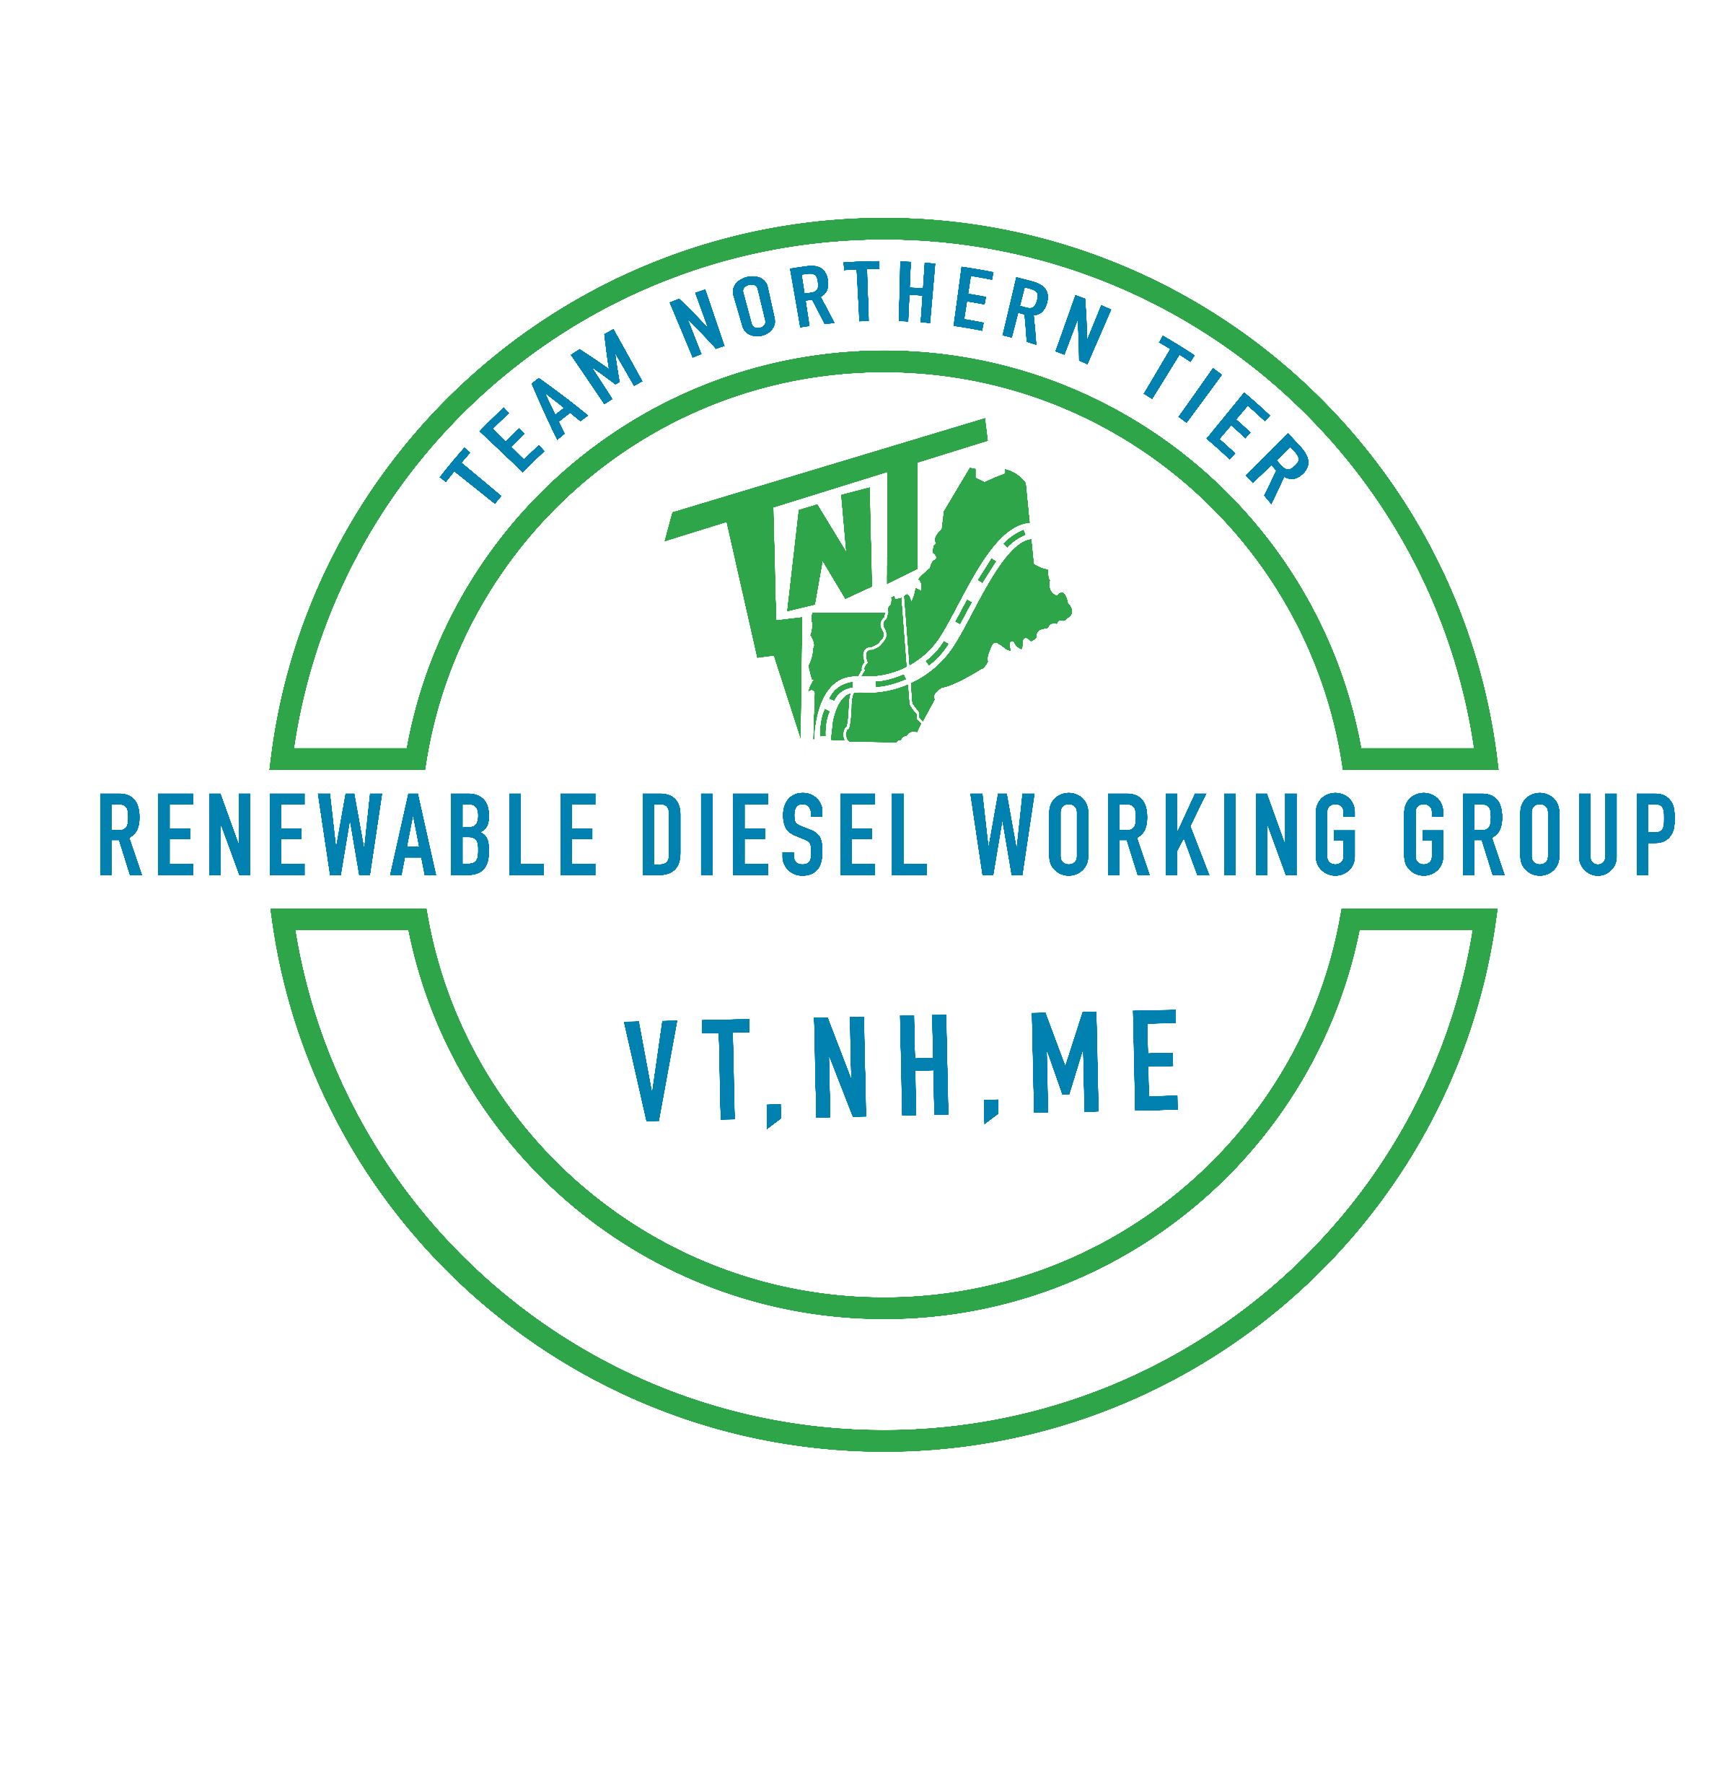
Agenda
Welcome & Recap
Renewable Diesel Procurement
Renewable Diesel in Adjacent Markets
Updates from Maine and Vermont
Wrap-up & Next Steps
Working Group Session 3
Topic: Renewable Diesel Policy

Slide 5
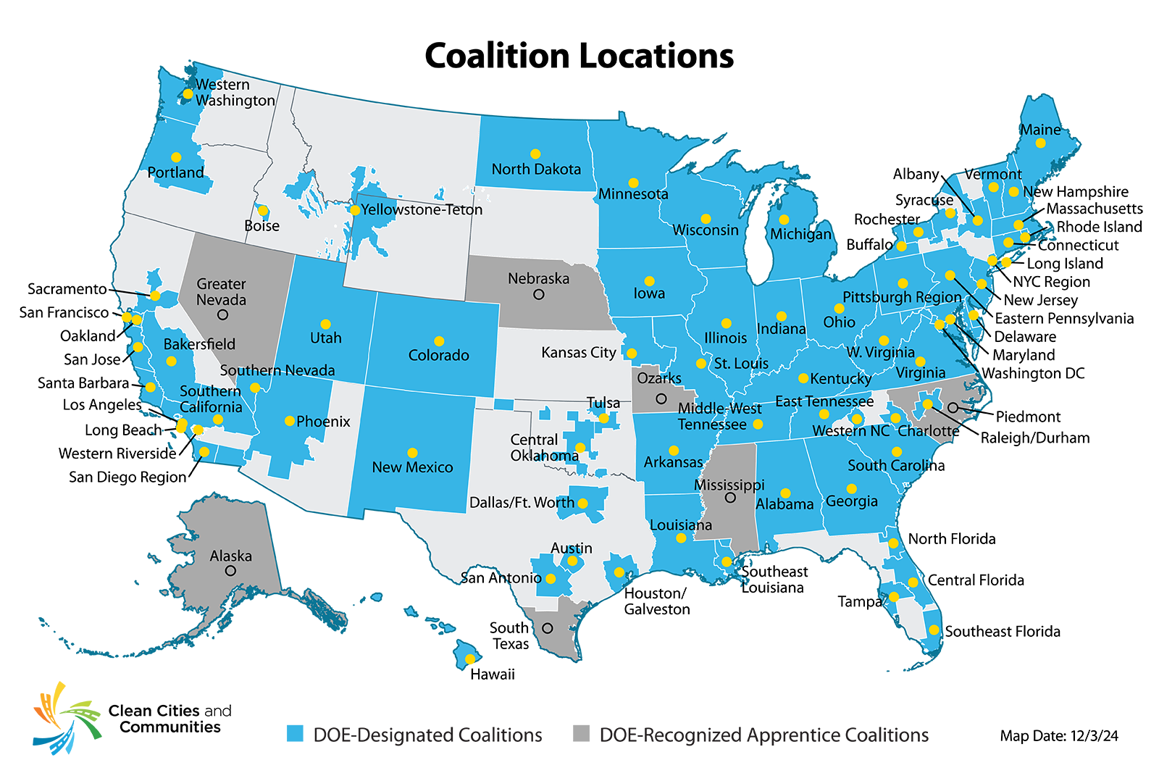
What We Do
Clean Cities and Communities is a U.S. Department of Energy (DOE) partnership to advance clean transportation nationwide.
More than 75 DOE-designated Clean Cities and Communities coalitions work locally in urban, suburban, and rural communities to strengthen the nation’s environment, energy security, and economic prosperity.
Notes:
Clean Cities and Communities is a U.S. Department of Energy partnership to advance clean transportation nationwide.
So, what does that mean?
Coalitions work locally in urban, suburban, and rural communities across the country. We advance affordable, efficient, and clean transportation, energy efficient mobility systems, and fuel-saving technologies and practices.
Coalitions are partners with the U.S. Department of Energy, or DOE. We bring expertise from federal agencies, national laboratories, and fellow coalitions directly to the communities we serve to develop and implement clean transportation solutions based on our knowledge of local needs, opportunities, and markets.
Our relationships allow us to build connections between DOE and local communities by leveraging national-level expertise to provide technical assistance to the regions we serve.
We also share insights and feedback from our on-the-ground deployment efforts and local stakeholder engagement to inform DOE activities, resources, and priorities. It’s a collaborative feedback loop with the Technology Integration Program team in DOE’s Vehicle Technologies Office.
Our coalition and the others around the country help local decision makers and fleets understand and implement clean transportation technologies and choices, including:
Shifting to affordable, efficient, and clean transportation fuels and technologies
Reducing greenhouse gas emissions
Assessing shared mobility options
Improving equitable access to advanced transportation.

Slide 6




Strategically Advance Clean Transportation
Access technical assistance and hands-on problem-solving support.
Connect to unbiased, data-driven tools and resources
Build partnerships
Receive personalized experience rooted in local context
Collaborate on funding opportunities
Notes:
Coalition staff provide technical expertise and hands-on problem-solving support to tailor clean transportation projects to unique needs. This expertise includes:
Evaluating the clean transportation technology options that meet on-the-ground needs and can reduce costs, energy consumption, and traffic congestion
Developing strategies to reduce emissions of greenhouse gases and other pollutants
Building collaborative relationships with communities, fleets, and industry partners to solve problems and identify and address technology barriers
Identifying funding opportunities for clean transportation and assisting with navigating funding application processes.

Slide 7
Northeast Working Group
Maine Ski Mountain Inquires about RD Supply
Boyne Reports is already using RD in their operations for mountains out west. What is the availability in the Northeast.
ME, NH, VT Host Greening Your Gears
First RD webinar. Coalitions applied for Jumpstart funding following success.
Nov.
2023
May
2025
August
2023
Sept.
2024
NYC Announces Citywide Transition
NYC commits to transitioning 100% of diesel usage to renewable diesel in all fleet operations. 16 million gallons.
First Working Group Session Kicks-off
Discussed general overview of renewable diesel including RD market, steps to convert a fleet, and benefits of low-carbon fuel standard to close cost delta.
Notes:
100 percent of the city’s 12,500 heavy-duty and off-road vehicles have completed the transition to renewable diesel, making New York City the first major East Coast city to implement this green technology at such a large scale. The transition will prevent 162 million pounds of global carbon dioxide emissions from entering the air every year, and it will serve as an important bridge fuel as viable electric versions of these vehicles are developed and placed into the market.

Slide 8



Jumpstart Funding
National Renewable Energy Lab
Connect Stakeholders
Assess current and future demand for renewable diesel
Consider heavy-duty on- and off-road applications, including agriculture, the ski industry
Determine fueling needs, capacity, training needs and cost effectiveness to transition to renewable diesel
Market Development
Fleet Solutions
Notes:
Now, I wanted to give a little more context behind this work and why we’re doing it. This quarterly working group session is a results of both Vermont and Maine Clean Communities receiving funding from the National Renewable Energy Lab, or NREL, to coordinate and convene these quarterly working group sessions.
We’ve learned a lot about renewable diesel since we started discussions with stakeholders and fleets in the Northeast over a year ago, which led to use hosting our first renewable diesel webinar in September of 2024. Building off the success from that webinar, we wanted to do a deeper dive to assess the current and future demand for renewable diesel, consider heavy-duty on- and off-road applications, and understand fueling needs, capacity, logistics and cost needed to bring RD further northern.

Slide 9


Session Topics
Renewable Diesel Introduction
Logistics
Session topics and the agendas will remain flexible to respond to what fleets find the most beneficial
Policy
Implementation
Renewable Diesel Market Development in the Northeast

Slide 10
Session Topics
Renewable Diesel Introduction
Logistics
Session topics and the agendas will remain flexible to respond to what fleets find the most beneficial
Policy
Implementation
Renewable Diesel Market Development in the Northeast

Slide 11


Shailesh Gongal
Manager Aviation Planning
Massachusetts Port Authority
Tom Bradley
VP of Sustainability
Boyne Resorts
Notes:
Develop Long-term Fleet Decarbonization Strategy - Massport will complete fleet decarbonization studies and develop an Authority wide strategy to decarbonize light and heavy duty vehicles across aviation and maritime facilities. • Results of Goal 1: Massport completed the fleet decarbonization studies and began executing a sustainability plan for its vehicle fleet, including the purchase of more than 100 hybrid vehicles, plug-in hybrids, and electric vehicles (EVs). Massport is also advancing the use of renewable diesel after successfully completing a renewable diesel pilot project on diesel snow plows, on-airport and off airport buses, street sweepers and other equipment, which demonstrated that renewable diesel is a viable energy substitute for operational equipment and reducing emissions until electric or other technology zero-emissions equipment are commercially available.

Slide 12
Renewable Diesel
60 -70%
on average
Pros
Drop-in fuel
Lower lifecycle emissions than conventional diesel
Cleaner burning → maintenance benefits
Immediate
decarbonization option
Challenges
Need to consider cold climate modifications
Group procurement for fueling and price
Need anchor fleet for fuel demand
Notes:
Renewable Diesel - fuel made from fats and oils, such as soybean oil or canola oil in depending on whether or not the fuel is domestically or internationally produced. It is processed to be chemically the same as petroleum diesel.
Meets the ASTM D975 specification for petroleum diesel.
Both fuels produce similar CO₂ per gallon burned, but RD100 has much lower lifecycle emissions, however renewable diesel reduces carbon intensity on average by 65% when compared with petroleum diesel.

Slide 13

Renewable Diesel Biodiesel
Renewable Diesel - fuel made from fats and oils, such as soybean oil or canola oil. It is processed to be chemically the same as petroleum diesel. Meets the ASTM D975 specification for petroleum in the United States. Renewable diesel can be used as a replacement fuel or blended with any amount of petroleum diesel.
Carbon Intensity - measures total greenhouse gas emissions across the full life cycle of a fuel, from production to use.
Biogenic CO₂ Emissions - are CO₂ emissions related to the natural carbon cycle, as well as those resulting from the combustion, harvest, combustion, digestion, fermentation, decomposition, or processing of biologically based materials.
Notes:
renewable diesel reduces carbon intensity on average by 65% when compared with petroleum diesel.

Slide 14
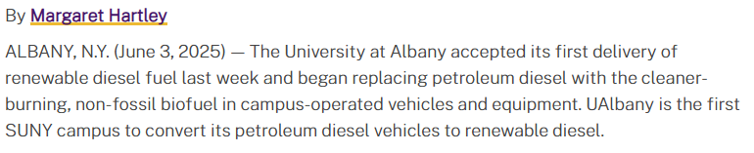
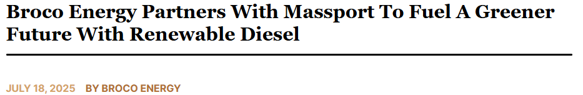

Renewable Diesel in the Northeast is Growing
Notes:
Honorable mentions: Yale

Slide 15
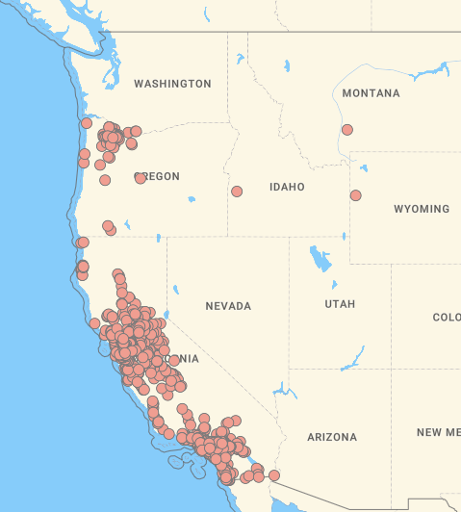
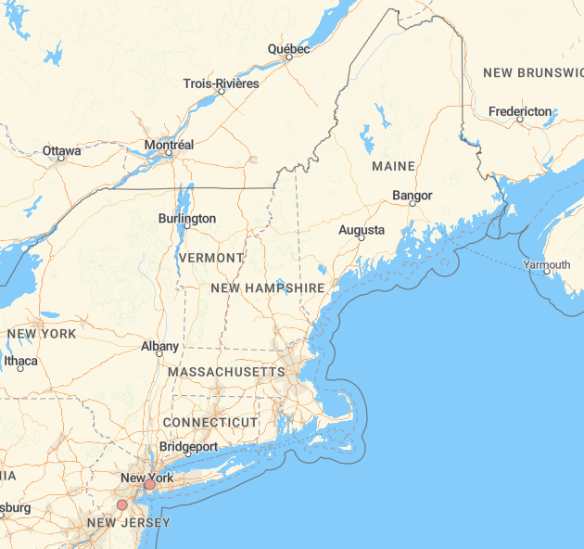
Notes:
Public fueling stations. For the April 2025 report,
directors reported 113 RD prices from CA and one price each from Idaho, Montana and Wyoming. The average
retail price for RD in CA for this report was $4.94/gallon, while the average retail diesel price in CA was
$4.94/gallon. The three RD prices submitted from the other states were significantly lower than in CA, averaging
$4.30/gallon, bringing the overall average price of RD in this report to $4.92/gallon.
Montana - Belgrade Cardlock, $4.49/gallon
Idaho - Conrad & Buffer Inc., $4.14/gallon
Wyoming - Shell, (called them, didn’t pick up, left voicemail, hopefully they will call back)
New Jersey - K W Rastail Oil Co., $4.39/gallon
New York - Sonomax, $4.29/gallon

Slide 16
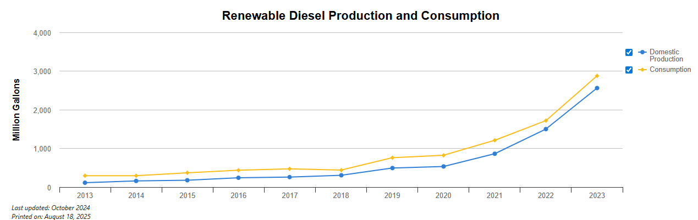
Notes:
42 gallons per barrel. 2,875,000,000 gallons of 2023 consumption
The U.S. Energy Information Administration (EIA) increased its forecast for 2026 renewable diesel production in its latest Short-Term Energy Outlook
The EIA now predicts renewable diesel production will average 260,000 barrels per day in 2026, up from 210,000 barrels per day in 2025.
The agency maintained its forecast that renewable diesel consumption will average 230,000 barrels per day in 2026. Renewable diesel consumption was at 240,000 barrels per day last year.

Slide 17

AFLEET Refuse Truck
492 MT CO₂
1,021 MT CO₂
2,560 MT CO₂
Electric
Renewable diesel 100
Diesel
Significant decarbonization
Zero tailpipe emissions
Bridge fuel
Use existing equipment & infrastructure
Conventional
Notes:
AFLEET Inputs - Alternative Fuel Life-Cycle Environmental and Economic Transportation
comparing an EV, RD100 and diesel refuse truck with 1.7 mpge - EV 6.2
23,000 miles per year over 15 years
Fuel prices - diesel: $3.85, electric $0.21 kwh, R100 $4.49

Slide 18
Presentations
Joe Natale, RenStar, LLC.
joen@renstarllc.com
Matt Cota, Meadow Hill
matt@meadowhillvt.com
Ken Jones, Retired Economic Research Analyst
Alex DePillis, Vermont Agency of Agriculture
Alex.DePillis@vermont.gov

Slide 19
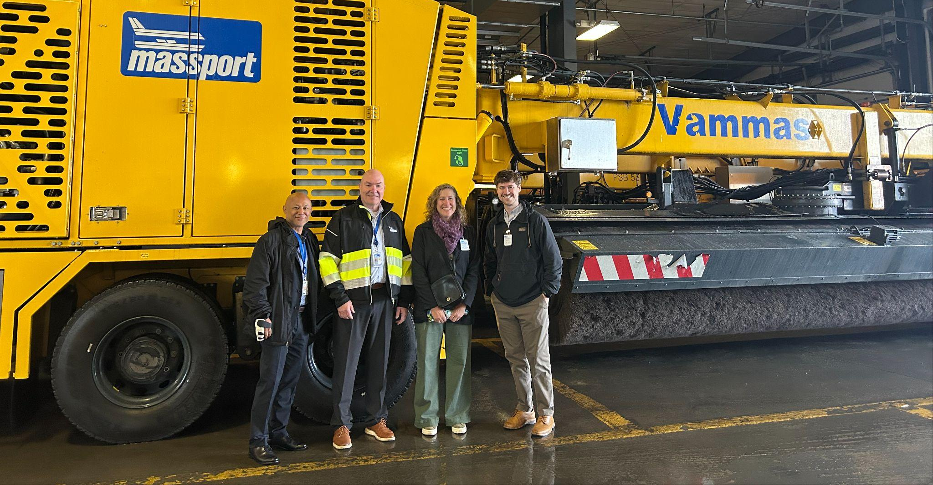
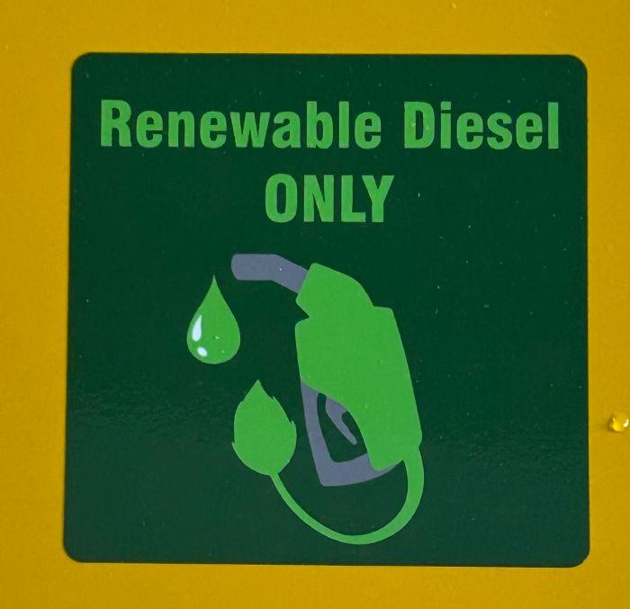
Notes:
Honorable mentions: Yale

Slide 20
Key Takeaways
Renewable diesel group procurement - who holds that role?
  Regional LCFS? Someone from the State air agencies
Our states don’t have any formal mandates - creates challenges to sell to NE markets
Agriculture sector can be part of the solution
RD will have the most impact in older vehicles

Slide 21
Thank you
Peggy O'Neill-Vivanco: poneillv@uvm.edu
Jon Gagne: jgagne@gpcog.org
Next session: Implementation
Wednesday, February 4th Noon – 1:30PM

Slide 22








































Icon Library – Modes of Transportation

Slide 23












Icon Library – Fuels and Technologies

