Slide 1
Northeast Renewable Diesel Working Group
Session 4 – February 4th, 2025

Slide 2

Agenda
Welcome & Recap
Running a Successful Pilot Program
Shifting Towards Implementation
Facilitated Discussion
Next Steps
Working Group Session 4
Topic: Renewable Diesel Implementation

Slide 3

Introductions
Please introduce yourself in the chat
Name
Organization
Where are you calling in from?

Slide 4




Vermont and Maine Clean Communities
Peggy O’Neill-Vivanco
Jon Gagne
Vermont Clean Communities
Coalition Director
Maine Clean Communities
Coalition Co-Director

Slide 5



Jumpstart Funding
National Lab of the Rockies
Connect Stakeholders
Assess current and future demand for renewable diesel
Consider heavy-duty on- and off-road applications, including agriculture, the ski industry
Determine fueling needs, capacity, training needs and cost effectiveness to transition to renewable diesel
Market Development
Fleet Solutions
Notes:
Now, I wanted to give a little more context behind this work and why we’re doing it. This quarterly working group session is a results of both Vermont and Maine Clean Communities receiving funding from the National Renewable Energy Lab, or NREL, to coordinate and convene these quarterly working group sessions.
We’ve learned a lot about renewable diesel since we started discussions with stakeholders and fleets in the Northeast over a year ago, which led to use hosting our first renewable diesel webinar in September of 2024. Building off the success from that webinar, we wanted to do a deeper dive to assess the current and future demand for renewable diesel, consider heavy-duty on- and off-road applications, and understand fueling needs, capacity, logistics and cost needed to bring RD further northern.

Slide 6


Session Topics
Renewable Diesel Introduction
Logistics
Session topics and the agendas will remain flexible to respond to what fleets find the most beneficial
Policy
Implementation
Renewable Diesel Market Development in the Northeast

Slide 7
Session Topics
Renewable Diesel Introduction
Logistics
Session topics and the agendas will remain flexible to respond to what fleets find the most beneficial
Policy
Implementation
Implementation
Renewable Diesel Market Development in the Northeast

Slide 8
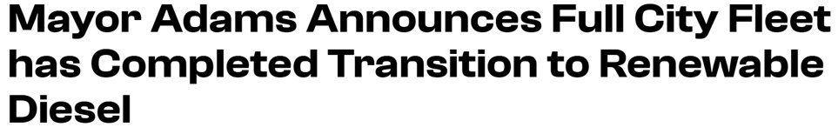
The transition represents an estimated 16 million gallons of renewable diesel supplied to NYC fleet operations.​
October 2024 - First large-scale implementation of RD on the East Coast​ 12,500 heavy-duty on and off-road vehicles are running on RD​
"Transition will prevent 162 million pounds of CO2 emissions every year"​
Fuel is supplied by Sprague and Approved Oil
Notes:
Plan evaluation before pilot starts: Have a simple evaluation framework ready to go.
Be crystal clear about the purpose of the pilot
Before touching fuel, answer this in one sentence:
“What decision will this pilot enable us to make?”
Common (good) goals:
Verify vehicle compatibility across specific engine models
Understand operational impacts (cold weather, fuel economy, maintenance)
Compare emissions reductions vs. cost
Test procurement and logistics (contracts, delivery, storage)
Avoid pilots that are just “try it and see.” If you can’t name the go/no-go decision at the end, the pilot is underdefined.
Operational metrics
Fuel economy (mpg or gallons/hour)
Cold starts (especially <20°F)
Driver-reported performance
Unplanned downtime
Maintenance metrics
Fuel filter changes
Injector or seal issues
Oil analysis (optional but powerful)
Maintenance cost deltas
Environmental metrics
GHG reductions (well-to-wheel, if possible)
Criteria pollutant proxy indicators (idle smoothness, smoke)
Cost metrics
Fuel price vs. ULSD
Cost per ton of CO₂e reduced
Admin/procurement burden
📌 Build a simple pre-pilot baseline using the same vehicles on ULSD.
Ask:
Did vehicles operate normally?
Were there measurable maintenance impacts?
Were emissions benefits credible and defensible?
Was procurement scalable?
What would change at 2× or 5× volume?
2. Choose the right vehicles (this matters a lot)
Don’t pilot on everything. Be selective.
Best candidates
High fuel users (refuse, transit, snow plows, regional haul)
Vehicles with predictable duty cycles
Engines with OEM approval for RD (ASTM D975)
Avoid
Rare or legacy engines with unclear fuel tolerance
Vehicles with inconsistent fueling locations
Low-use vehicles (you won’t get meaningful data)
👉 Tip: Pick 10–20% of a homogeneous sub-fleet rather than a random sample.

Slide 9


Matt Leuck
Technical Manager, RD
Session 1
RD Intro
NESTE joins the first working group to give a comprehensive introduction to RD
Renewable diesel as a drop in fuel. Meeting same ASTM specs at diesel
Sourcing, feedstocks, production and distribution
Ways to close the price gap between standard diesel and RD:
  Federal tax credits and subsidies
  Bills to incentivize production (done in Texas)
  Local renewable/low-carbon fuel standards
Notes:
Honorable mentions: Yale

Slide 10


Shailesh Gongas
Massachusetts Port Authority
Session 2
Logistics
Massachusetts Port Authority successfully completes RD pilot in Fall 2025
NetZero by 2031 targets, goals and strategies.
External due diligence and an overview of discussions with fuel suppliers, distributors, refiners, and manufacturers to build fuel confidence
Logistics for fueling, transportation, operations
Notes:
Honorable mentions: Yale

Slide 11

Tom Bradley
VP of Sustainability
Session 2
Logistics
Renewable diesel deployment on ski mountains has been successfully demonstrated on the West Coast with over 100,000 gallons used
Cypress Mountain in North Vancouver, BC
  Focus on cold climate, piloting R30, scaling up to R50 and transitioning to R100 for winter 2024-2025.
Big Sky Resort, Montana
  Piloted a Sinclair Summer blend of R99 in Fall 2024
Snoqualmie Pass, Washington State
  Using Neste R99 products which is a specific winter blend
Notes:
Honorable mentions: Yale

Slide 12
Alex DePillis
VT Agency of Agriculture
Matt Cota
Meadow Hill Consulting
Session 3
Policy
Limited equipment/fuel options for off-road/farm vehicles and heavy-duty trucks.
Potential for Vermont oilseed crops. Camelina sativa
Allow geographical optimization.
  Grow oilseeds near feedmill/crushing plant,
  Near livestock for feed!
Challenging for industry to sell lower carbon product because of different incentive structures.
Need programs to compel buyers to purchase lower carbon products.
Regional Low Carbon Fuel Standard (LCFS).
Notes:
Camelina stavia: Small seed, short and early growth
400,000 seeds per pound, seeding rate of 3 lbs/acre
early spring plant, maturity ~80 days
Oil content of 35-40 % and stable.
Low fertilizer input.
2000+ lbs per acre yield potential
Much boosterism, much to be learned.

Slide 13
Joe Natale
RenStar, LLC
Ken Jones
Retired Economic Research Analyst
Session 3
Policy
Renewable diesel pilot with MBTA commuter rail
Breaking down and understanding the language and costs for a fuel RFP
Bring in thermal sector for demand.
Need to combat negative messaging around seed oil RD.
Look to Carbon Intensity values and research in CA.
Significant appetite for low carbon fuels.
Develop whole market for RD.
Notes:
Honorable mentions: Yale

Slide 14
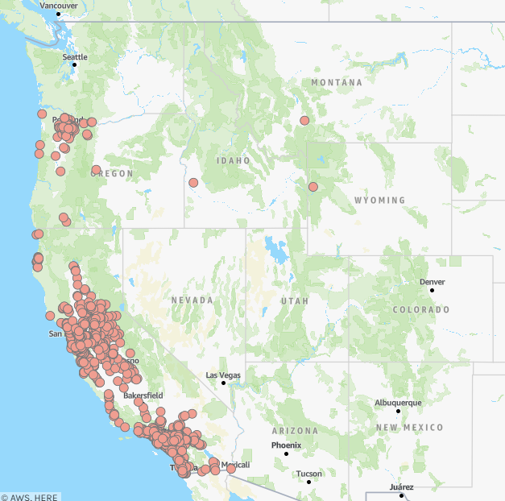
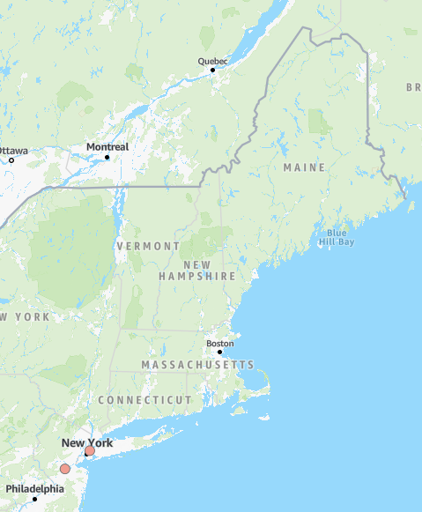
West Coast vs. New England
RD fueling locations
Known pilot projects
Notes:
California’s Low Carbon Fuel Standard – Incentive program designed to lower the carbon intensity of transportation fuels through a credit system. Producers who sell to LCFS markets receive a credit that can be sold to other fuel producers that are refining convention fossil fuel petroleum fuels and putting them into the LCFS market. This helps drive the price of the fuel down
Public fueling stations. For the April 2025 report,
directors reported 113 RD prices from CA and one price each from Idaho, Montana and Wyoming. The average
retail price for RD in CA for this report was $4.94/gallon, while the average retail diesel price in CA was
$4.94/gallon. The three RD prices submitted from the other states were significantly lower than in CA, averaging
$4.30/gallon, bringing the overall average price of RD in this report to $4.92/gallon.
Montana - Belgrade Cardlock, $4.49/gallon
Idaho - Conrad & Buffer Inc., $4.14/gallon
Wyoming - Shell, (called them, didn’t pick up, left voicemail, hopefully they will call back)
New Jersey - K W Rastail Oil Co., $4.39/gallon
New York - Sonomax, $4.29/gallon

Slide 15
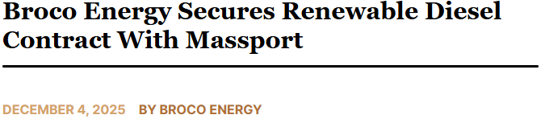
Massachusetts Port Authority
Deployment
The one-year contract represents an estimated 1.2 million gallons of renewable diesel supplied to Massport's operations.
Logan Airport shuttle buses (Logan Express)
Maintenance vehicles and grounds equipment
Luggage carriers, generators, and support systems
Fire trucks and emergency response units
All internal Massport diesel-powered equipment
Notes:
Honorable mentions: Yale

Slide 16

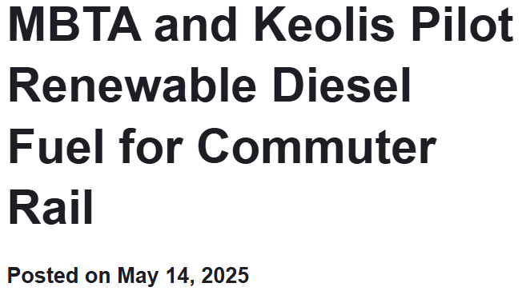
RenStar, LLC
Pilot
The pilot marks the first use of Renewable Diesel (R99) in MBTA commuter locomotives as well as the first such program in North America.
Developed in partnership with the MBTA, the pilot includes all locomotives that lay over at the Newburyport Commuter Rail facility
  Collaboration between Keolis, MBTA, and RenStar, initially using local Boston truck racks and then Providence Rail Terminal for scalability for rail receipt and truck delivery.
Over 500,000 gallons of Renewable Diesel have been delivered and consumed by MBTA locomotives with zero performance issues.
Next phase: Scaling from pilot to broader deployment and evaluating direct-rail deliveries to MBTA yards for cost efficiency and carbon tracking.
Notes:
Honorable mentions: Yale

Slide 17
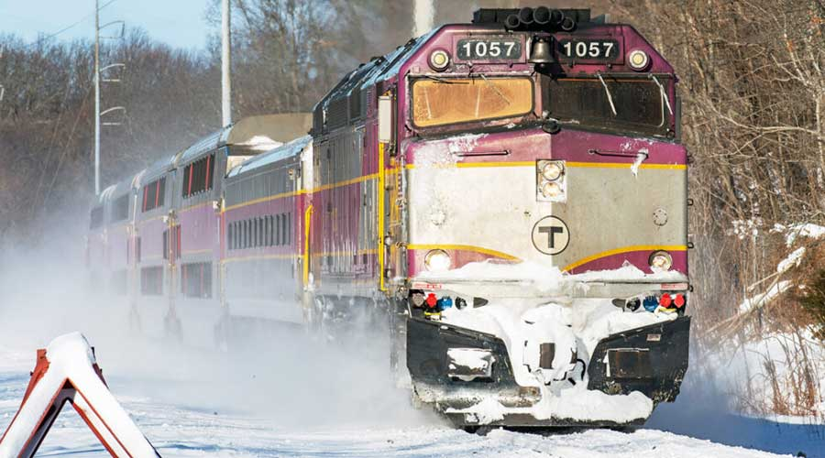
RenStar, LLC
Pilot
Rail functions as floating storage in a region with limited bulk tankage.
  Each DOT-117 railcar (~27–30K gal) serves as both inventory and logistics asset, providing flexibility and seasonal security.
  Enables direct tie-in from domestic RD production hubs (Gulf & West Coast) to Northeast demand centers.
  Rail integration bridges the gap between producers and end-users, reducing dependency on marine imports and improving supply resiliency.
  Supports multi-market optimization… same rail assets can supply transit, heating oil, and municipal fleets.
Longer-term, moving towards evaluating full transition to renewable diesel supply across MBTA operations; integrate carbon tracking and reporting.
Notes:
As the nation’s fifth-busiest rail system, MBTA Commuter Rail serves nearly 90,000 passengers on weekdays.

Slide 18


Pilot
SUNY Albany
Summer 2025: SUNY Albany takes delivery of RD for medium- and heavy-duty vehicles
Running in buses, H-D utility vehicles, mowers
Supply from Sprague Energy in Rensselaer
Goals: lower emissions, move away from fossil fuels, improve air quality & support climate goals
Notes:
AFLEET Inputs - Alternative Fuel Life-Cycle Environmental and Economic Transportation
comparing an EV, RD100 and diesel refuse truck with 1.7 mpge - EV 6.2
23,000 miles per year over 15 years
Fuel prices - diesel: $3.85, electric $0.21 kwh, R100 $4.49

Slide 19
Running a Successful Pilot - the setup
Identify purpose of pilot
Plan the evaluation before the pilot starts
Track metrics before the pilot starts
  Build a pre-pilot baseline with same vehicles on ULSD
  Operational
  Maintenance
  Emissions
  Cost
Choose the right vehicles - ideally 10–20% of a homogeneous sub-fleet
Notes:
Plan evaluation before pilot starts: Have a simple evaluation framework ready to go.
Be crystal clear about the purpose of the pilot
Before touching fuel, answer this in one sentence:
“What decision will this pilot enable us to make?”
Common (good) goals:
Verify vehicle compatibility across specific engine models
Understand operational impacts (cold weather, fuel economy, maintenance)
Compare emissions reductions vs. cost
Test procurement and logistics (contracts, delivery, storage)
Avoid pilots that are just “try it and see.” If you can’t name the go/no-go decision at the end, the pilot is underdefined.
Operational metrics
Fuel economy (mpg or gallons/hour)
Cold starts (especially <20°F)
Driver-reported performance
Unplanned downtime
Maintenance metrics
Fuel filter changes
Injector or seal issues
Oil analysis (optional but powerful)
Maintenance cost deltas
Environmental metrics
GHG reductions (well-to-wheel, if possible)
Criteria pollutant proxy indicators (idle smoothness, smoke)
Cost metrics
Fuel price vs. ULSD
Cost per ton of CO₂e reduced
Admin/procurement burden
📌 Build a simple pre-pilot baseline using the same vehicles on ULSD.
Ask:
Did vehicles operate normally?
Were there measurable maintenance impacts?
Were emissions benefits credible and defensible?
Was procurement scalable?
What would change at 2× or 5× volume?
2. Choose the right vehicles (this matters a lot)
Don’t pilot on everything. Be selective.
Best candidates
High fuel users (refuse, transit, snow plows, regional haul)
Vehicles with predictable duty cycles
Engines with OEM approval for RD (ASTM D975)
Avoid
Rare or legacy engines with unclear fuel tolerance
Vehicles with inconsistent fueling locations
Low-use vehicles (you won’t get meaningful data)
👉 Tip: Pick 10–20% of a homogeneous sub-fleet rather than a random sample.

Slide 20
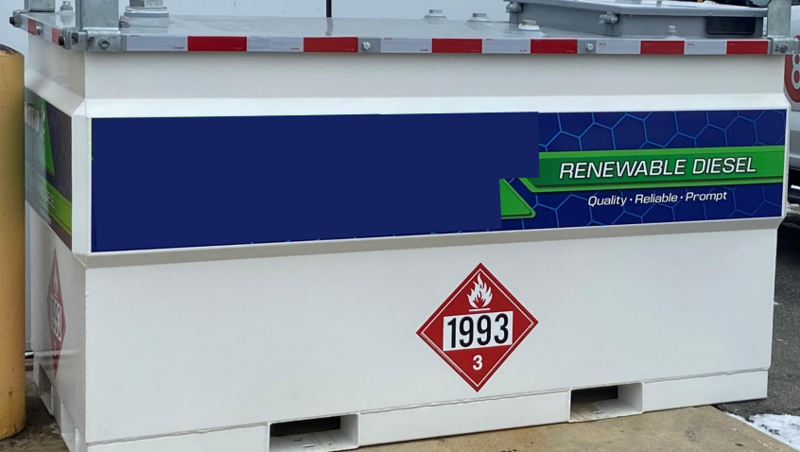
Running a Successful Pilot - fueling & logistics
Confirm fuel specs
  Fuel meets ASTM D975
  Feedstock and CI score
  Additive package
  Cold weather operability (cloud point, pour point)
Procurement and fuel availability
Fuel storage
Notes:
Confirm fuel specs and supply chain before launch
Renewable diesel ≠ biodiesel, and confusion here causes problems.
You need to lock down
Fuel meets ASTM D975 (not D6751)
Feedstock and CI score (if emissions accounting matters)
Additive package (especially lubricity)
Cold weather operability (cloud point, pour point)
Evaluate
Can the supplier deliver consistently?
Is this a spot purchase or a contract?
What happens if supply is interrupted mid-pilot?
⚠️ A pilot that dies due to fuel availability is not a “failed fuel”—it’s a procurement failure.
4. Storage, handling, and fueling logistics
Most fleets underestimate this part.
Assess
Existing tanks: compatibility, cleaning needs
Shared tanks vs. dedicated RD tanks
Risk of cross-contamination (esp. with biodiesel blends)
Winter storage practices
Decision to make
Do you need a dedicated tank for clean data?
Or is “drop-in use” part of what you’re testing?
If your long-term goal is drop-in adoption, your pilot should reflect that reality.

Slide 21
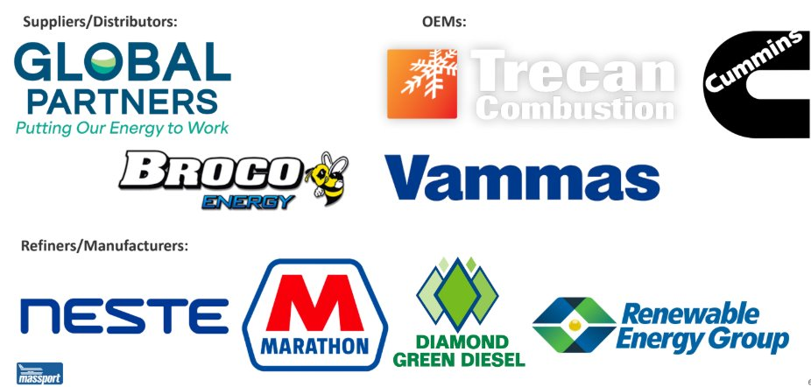
Running a Successful Pilot - stakeholders
Notes:
Train drivers and mechanics (don’t skip this)
Most “issues” in pilots are actually communication failures.
Do a short briefing covering
What RD is (and isn’t)
What to report and how
What not to change (no driving behavior changes)
Mechanics should know:
Expected filter behavior
What’s normal vs. a real problem
Who to escalate concerns to
If staff don’t trust the fuel, your data will be garbage.
7. Duration: long enough to be real, short enough to manage
Sweet spot:
3–6 months, or
One full season (especially winter)
Avoid:
<30 days (too short)
Open-ended pilots (decision paralysis)
Duration: long enough to be real, short enough to manage
Sweet spot:
3–6 months, or
One full season (especially winter)
Avoid:
<30 days (too short)
Open-ended pilots (decision paralysis)
8. Plan the evaluation before the pilot starts
Have a simple evaluation framework ready to go.
Ask:
Did vehicles operate normally?
Were there measurable maintenance impacts?
Were emissions benefits credible and defensible?
Was procurement scalable?
What would change at 2× or 5× volume?
End with a clear recommendation:
Scale
Scale with conditions
Pause / redesign
Do not proceed

Slide 22
Running a Successful Pilot - launch
Train drivers and mechanics
  What is RD
  No driving behavior changes
  Expected filter behavior
  What’s normal vs. a real problem
Duration
  3-6 months
  Full season
Evaluation
  Vehicle operations
  Maintenance impacts
  Emissions benefits
  Procurement
  Scalable
Notes:
Train drivers and mechanics (don’t skip this)
Most “issues” in pilots are actually communication failures.
Do a short briefing covering
What RD is (and isn’t)
What to report and how
What not to change (no driving behavior changes)
Mechanics should know:
Expected filter behavior
What’s normal vs. a real problem
Who to escalate concerns to
If staff don’t trust the fuel, your data will be garbage.
7. Duration: long enough to be real, short enough to manage
Sweet spot:
3–6 months, or
One full season (especially winter)
Avoid:
<30 days (too short)
Open-ended pilots (decision paralysis)
Duration: long enough to be real, short enough to manage
Sweet spot:
3–6 months, or
One full season (especially winter)
Avoid:
<30 days (too short)
Open-ended pilots (decision paralysis)
8. Plan the evaluation before the pilot starts
Have a simple evaluation framework ready to go.
Ask:
Did vehicles operate normally?
Were there measurable maintenance impacts?
Were emissions benefits credible and defensible?
Was procurement scalable?
What would change at 2× or 5× volume?
End with a clear recommendation:
Scale
Scale with conditions
Pause / redesign
Do not proceed

Slide 23
Shifting Towards Implementation
Cooperative Purchasing Agreements
Connor Smith, Capital Projects Manager, Green Mountain Transit

Slide 24
Facilitated Discussion
Moderator: Jessica Wilcox, Administrator, Technical Services Bureau NH Department of Environmental Services / Air Resources Division
Acting Director, Granite State Clean Cities Coalition
Please turn on your cameras.
Stay muted, unless speaking.
Raise your hand to speak.
Ask a question in the chat.

Slide 25

Renewable Diesel Biodiesel
Renewable Diesel - fuel made from fats and oils, such as soybean oil or canola oil. It is processed to be chemically the same as petroleum diesel. Meets the ASTM D975 specification for petroleum in the United States. Renewable diesel can be used as a replacement fuel or blended with any amount of petroleum diesel.
Carbon Intensity - measures total greenhouse gas emissions across the full life cycle of a fuel, from production to use.
Biogenic CO₂ Emissions - are CO₂ emissions related to the natural carbon cycle, as well as those resulting from the combustion, harvest, combustion, digestion, fermentation, decomposition, or processing of biologically based materials.
Notes:
renewable diesel reduces carbon intensity on average by 65% when compared with petroleum diesel.

Slide 26
Key Takeaways & Next Steps
Look for partners who want to form partnerships for the long-haul and explore pilot opportunities
Tie into the Sustainable Aviation Fuel (SAF) markets in MA
Mass Dept of Energy Resources is creating a RD policy guidance document - will share with group
Look at state diesel usage - can we bring together partners to capture a % of the market share
Framing RD against alternative fuel solutions rather than petroleum diesel
Cold weather operability is still top of mind for folks
Narrowing down from regional to local conversations

Slide 27
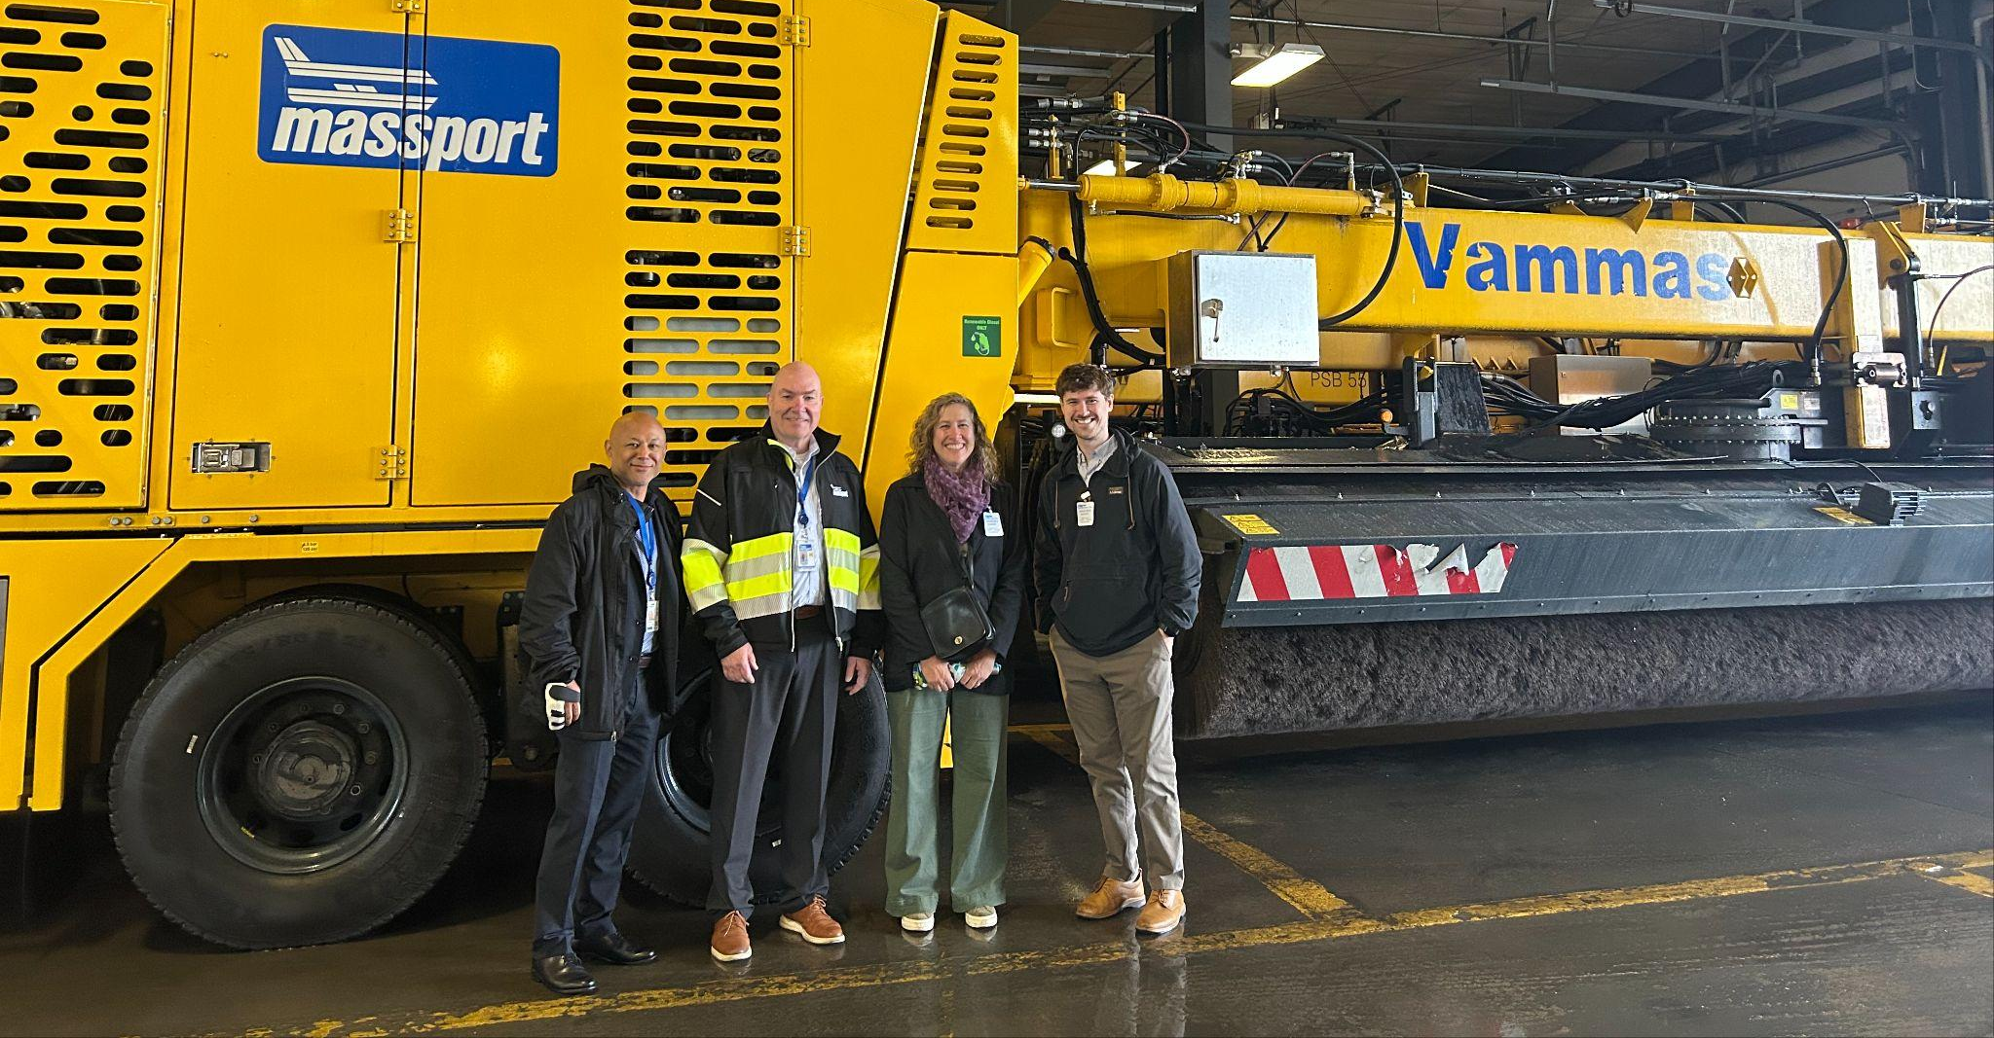
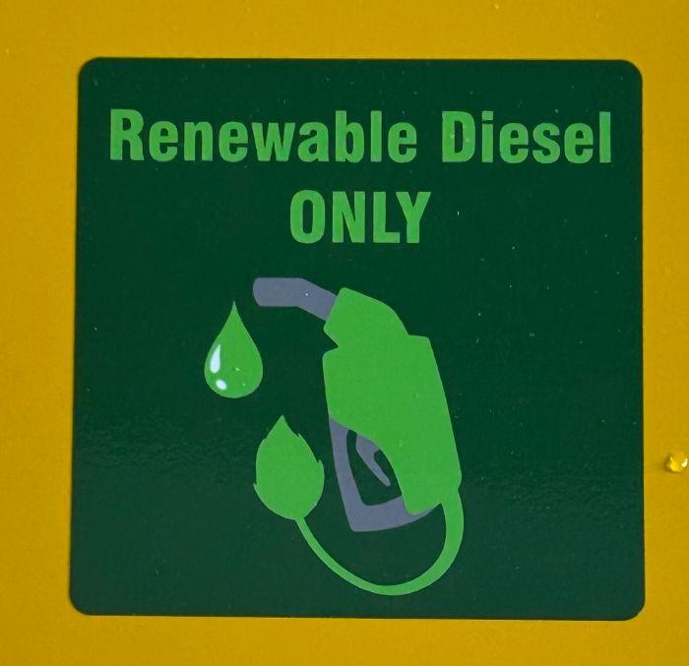
Notes:
Honorable mentions: Yale

Slide 28
Thank you
Peggy O'Neill-Vivanco: poneillv@vtcleancommunities.org
Jon Gagne: jgagne@gpcog.org

Slide 29







































Icon Library – Modes of Transportation

Slide 30












Icon Library – Fuels and Technologies

